Slide 1
Introduction to
Machine Learning

Slide 2
Why “Learn”?
Machine learning is programming computers to optimize a performance criterion using example data or past experience.
There is no need to “learn” to calculate payroll
Learning is used when:
  Human expertise does not exist (navigating on Mars),
  Humans are unable to explain their expertise (speech recognition)
  Solution changes in time (routing on a computer network)
  Solution needs to be adapted to particular cases

Slide 3
Applications
Association Analysis
Supervised Learning
  Classification
  Regression/Prediction
Unsupervised Learning
Reinforcement Learning

Slide 4

Learning Associations
Basket analysis:
P (Y | X ) probability that somebody who buys X also buys Y where X and Y are products/services.
Example: P ( chips | beer ) = 0.7
Market-Basket transactions

Slide 5
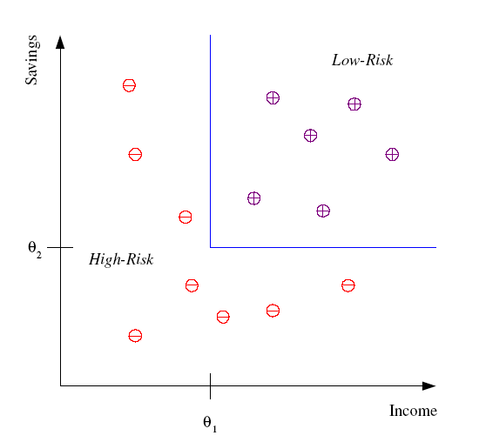
Classification
Example: Credit scoring
Differentiating between low-risk and high-risk customers from their income and savings
Discriminant: IF income > θ₁ AND savings > θ₂
THEN low-risk ELSE high-risk
Model

Slide 6
Classification: Applications
Document classification: Tweets to categories
Face recognition: Pose, lighting, glasses, beard, make-up, hair style
Character recognition: Different handwriting styles.
Speech recognition: Temporal dependency.
  Use of a dictionary or the syntax of the language.
  Sensor fusion: Combine multiple modalities; eg, visual (lip image) and acoustic for speech
Medical diagnosis: From symptoms to illnesses
Web Advertizing: Predict if a user clicks on an ad on the Internet.

Slide 7
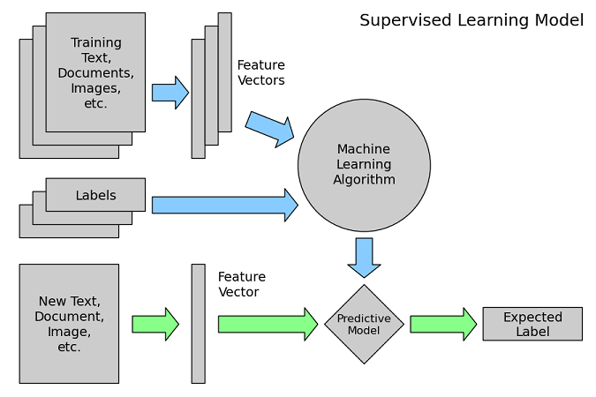
Supervised Machine Learning

Slide 8








Face Recognition
Training examples of a person
Test images
AT&T Laboratories, Cambridge UK
http://www.uk.research.att.com/facedatabase.html

Slide 9
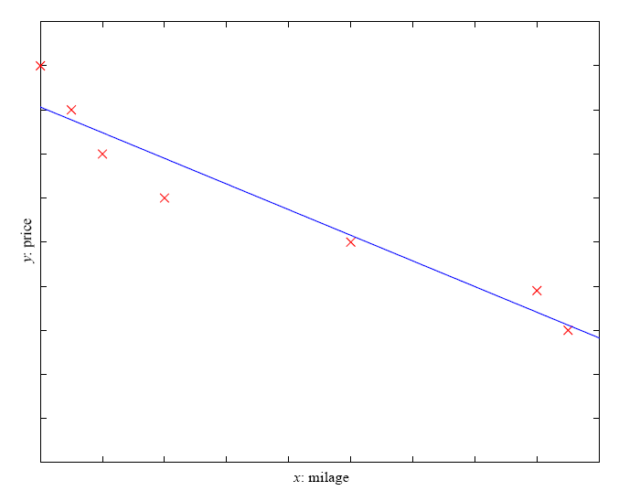
Prediction: Regression
Example: Price of a used car
x : car attributes
y : price
y = g (x | θ )
g ( ) model,
θ parameters
y = wx+w₀

Slide 10
Unsupervised Learning
Learning from “what normally happens”
No output
Clustering: Grouping similar instances
Other applications: Summarization, Association Analysis
Example applications
  Customer segmentation in CRM
  Outlier detection e.g. fraud

Slide 11
Reinforcement Learning
Topics:
  Policies: what actions should an agent take in a particular situation
  Utility estimation: how good is a state (→used by policy)
No supervised output but delayed reward
Credit assignment problem (what was responsible for the outcome)
Applications:
  Game playing
  Robot in a maze
  Multiple agents, ...

Slide 12
Resources: Datasets
UCI Repository: http://www.ics.uci.edu/~mlearn/MLRepository.html
UCI KDD Archive: http://kdd.ics.uci.edu/summary.data.application.html
Statlib: http://lib.stat.cmu.edu/
Delve: http://www.cs.utoronto.ca/~delve/

Slide 13
Assignment
UCI Repository: http://www.ics.uci.edu/~mlearn/MLRepository.html
Download the Iris dataset
Read its description
Identify what are different attributes, classes, and instances in the dataset

